Slide 1
Mnemonic Model

Slide 2

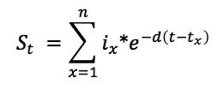
Basic Structure
Memory trace:
Episodes
Memory strength: probability of retrieval
Memory strength (S_{t}) is modeled as initial encoding strength (i) that decays exponentially
Additional study events’ effects are additive
Notes:
Memory changes over time
Strength is an internal parameter reflecting the current availability/activation of an episode
Episodes are distinct, unitized traces of experience

Slide 3
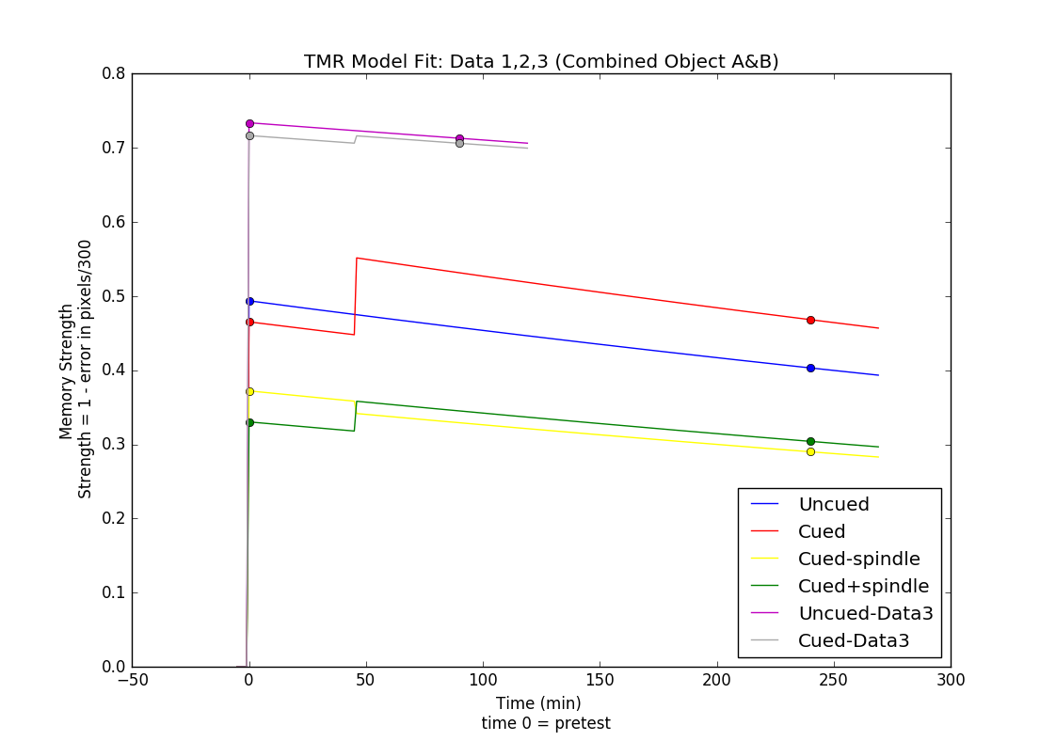

Preliminary Fit 1

Slide 4
Assumptions
Pre nap and post nap test could have measurement error
TMR all happened at 45 min in the nap
TMR effects are additive
Decay rate is the same for uncued and cued items.
Population decay rate could be estimated from the average pre nap and post nap performance; estimation from experiment 1 applicable to experiment 2
TMR/study events are more effective for weaker memories
Memory strength is measured as probability of successful retrieval

Slide 5
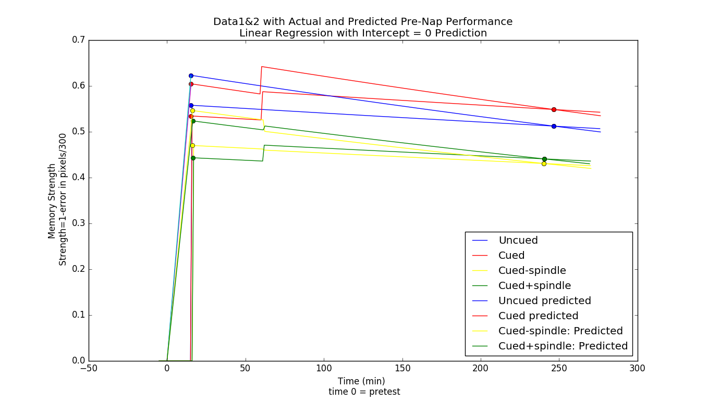
Predicted and Actual Pretest Comparison

Slide 6
Linear Regression
Smaller Standard Deviation in pretest
Data1
Predicted Cued = 0.301 vs actual = 0.339
Predicted Uncued = 0.293 vs actual = 0.324
Data2
Predicted Cued without spindle = 0.326 vs actual = 0.356
Predicted cued+spindle = 0.316 vs actual = 0.358
Higher pre nap test average and thus faster decay and smaller tmr boost
Notes:
data1 Predicted Cued mean: 0.604650560478; std= 0.301357074333 Predicted Uncued mean: 0.623226919124; std = 0.293459651014 actual Cued mean: 0.534482326287; std = 0.339012003076 actual Uncued mean: 0.557898713374; std = 0.323715682473
data2 Predicted Cued mean: 0.546296498453; std = 0.325759254754 Predicted cued+spindle mean: 0.523655355511; std = 0.316312930216 Actual Cued mean: 0.470060318438; std = 0.355922810702 Actual cued+spindle mean: 0.443269323682; std = 0.357571016045

Slide 7
Assumptions
Pre nap and post nap test could have measurement error
TMR all happened at 45 min in the nap
TMR effects are additive
TMR/study events are more effective for weaker memories
Memory strength is measured as probability of successful retrieval
Decay rate is the same for uncued and cued items.
Population decay rate could be estimated from the average pre nap and post nap performance; estimation from experiment 1 applicable to experiment 2

Slide 8
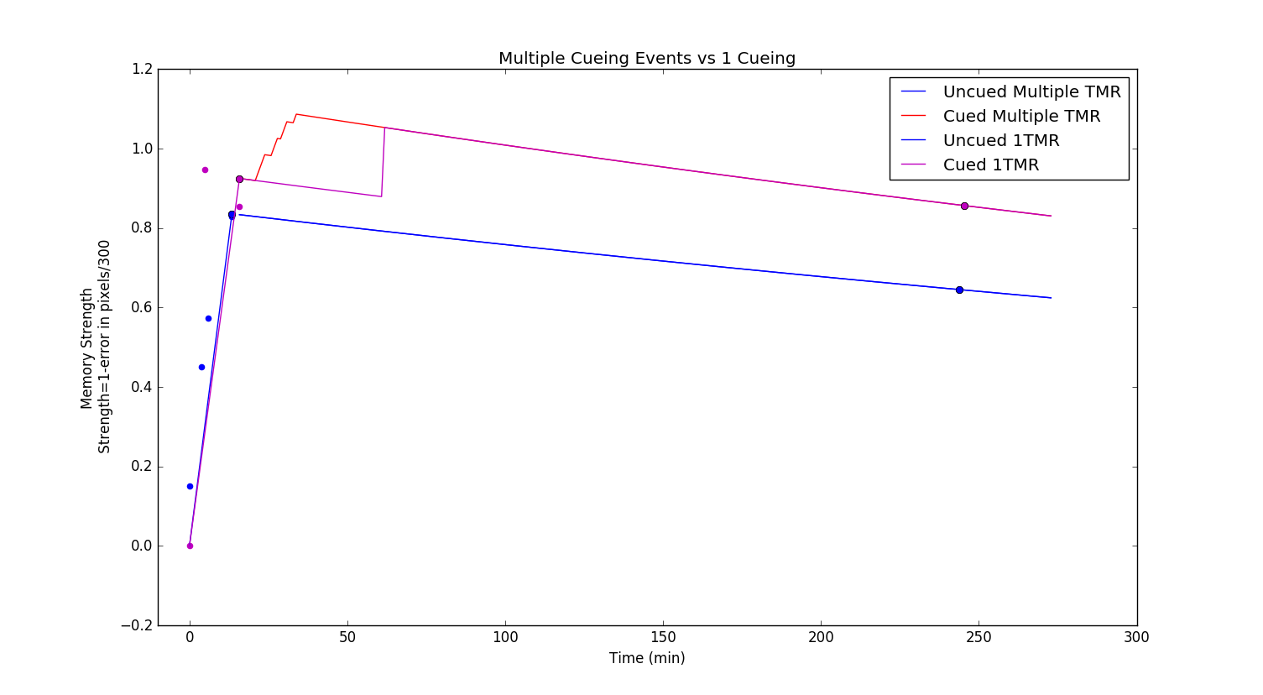
Linear Regression and Multiple TMR Fit
Decay parameter = -0.0011
TMR = 0.0301/cueing; cued 8 times
Initial Strength (predicted) = 0.9245
Boost/study = 0.308; about 10.2 tmr
Notes:
Sub19, 2 uncued 13 cued
number of study 3 0.9244966/3 = 0.3082 = 10.25 TMR
Sub19 Pic2 uncued Actual y in strength , decay: -0.00108440371563
Sub19 Pic13 TMR multiple events: 0.0300781165819

Slide 9
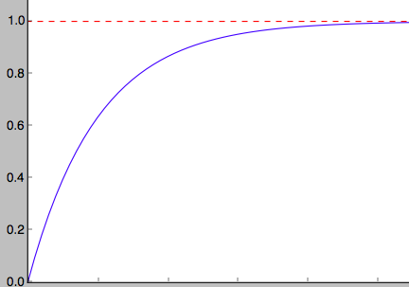



Bound Memory Strength
The target function:
Bounded between 0 and 1
Increases slower as the strength approaches 1
Where TMR is measured by
a percentage in memory strength

Slide 10
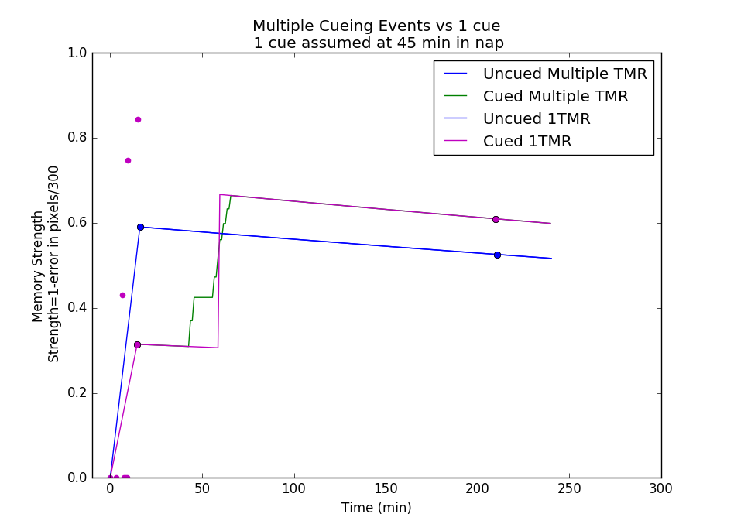
Current Model Fit

Slide 11

Current Model
TMR happens at different time according to the reconstructed timeline
Measurement error
use regression to counterbalance some pre nap measurement error
TMR effects are multiplicative and measured in percentage of the current memory strength
TMR/study events are more effective for weaker memories
Each TMR boost is the same in percentage
Memory strength is measured as probability of successful retrieval
Bounded between 0 and 1
Conversion from pixel to strength:
Existence of population decay rate
decay rate could be estimated from the uncued average pre nap and post nap performance; estimation from experiment 1 applicable to experiment 2

Slide 12
Other Future directions
Allow change in the decay parameter
Incorporate sleep physiology measures (spindles, sleep phase, SWS time, etc.)
Develop methods to verify the accuracy of the model
Notes:
- Decay parameter changeReactivation/restudy would modify the decay parameter, slowing the forgetting rate and extending the time from encoding to forgetting; like spaced practice, the more spaced, the larger the effect should be on the decay parameter
- verification: Make predictions for new experiment and measure the accuracy of the prediction
Find signals from existing data’s EEG recording that would indicate memory strength variations and compare with the model’s estimation

Slide 13
Experiment Procedures
Experiment 1 (48 images)
Learn sound-image pair to high degree → Learn image location until error within 150 pixels once → Pre nap test with feedback → Half item cued during SWS → leave lab for 2.5hrs → return for post test
Experiment 2
All items are cued, half of each category followed by amplitude-modulated white noise (AMWN)
Experiment 3 (50 pairs)
Learn the items-sound → Learn location until placing them correctly twice → pre nap test without feedback, each pair tested twice →Half item cued during SWS → post test immediately, twice each pair
Notes:
Spontaneous memory reactivation and potential as a supplement for natural learning
AMWN: 15Hz, starts 0.5s after and lasts for 2s
Categories: celebrities, landmarks, common objects, scrambled faces, scrambled places
exp1&2 cued selection: half from each category
Exp3 cued selection: sort prenap performance (4 measures, 2 objects and 2 tests); take every other pair
Feedback:
Exp1: item in the center with the question “Where” - then drag – item move to right location for 3s with sound presenting
Exp3: item associated with sound in the center – drag – bounce to right location – type name of the second object – appear in the center - drag – bounce to right location

